Slide 1


CREDIT CARD APPROVAL ANALYSIS
Enaam
Shaza
Zainab
Bisma

Slide 2



Introduction
Credit cards play a pivotal role in modern finance, offering convenience and flexibility to consumers globally. This dataset from Kaggle provides insights into the credit card approval process, allowing us to analyze approval rates and uncover key factors influencing them.

Slide 3
Purpose
The purpose of our project is to leverage machine learning techniques to predict credit card approval decisions effectively. Our model will enable financial institutions to automate the decision-making process, reduce manual errors, and ensure fair and efficient credit distribution.

Slide 4







DataPipeline
NumPy
Imbalanced-Learn
Scikit-learn
Matplotlib & Seaborn
Apache Spark

Slide 5



Data Visualizations

Slide 6

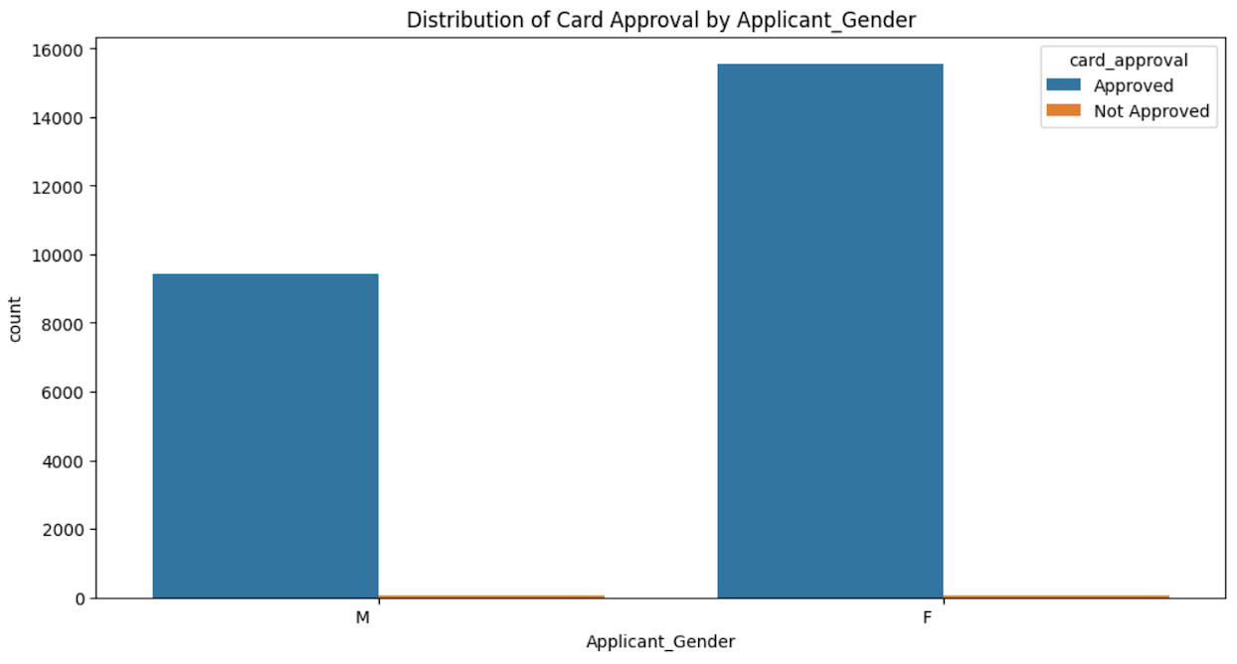

1
Gender
Our dataset exhibits a gender distribution skewed towards females, indicating a higher volume of female applicants compared to males for the credit card processor.

Slide 7
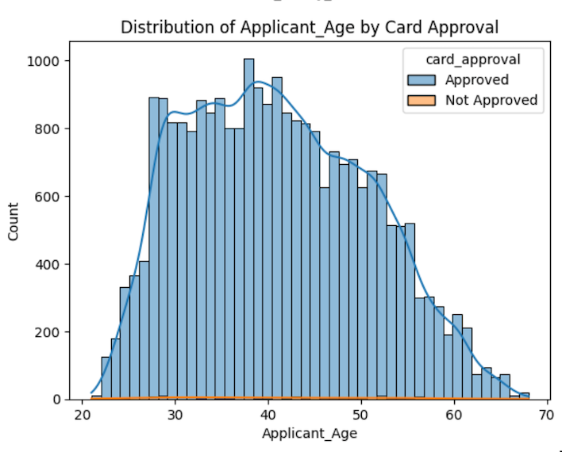
2
Age
From our dataset's histograms, we observed that a significant portion of applicants fall within the 30-45 age range, presenting a natural distribution of consumer ages.

Slide 8
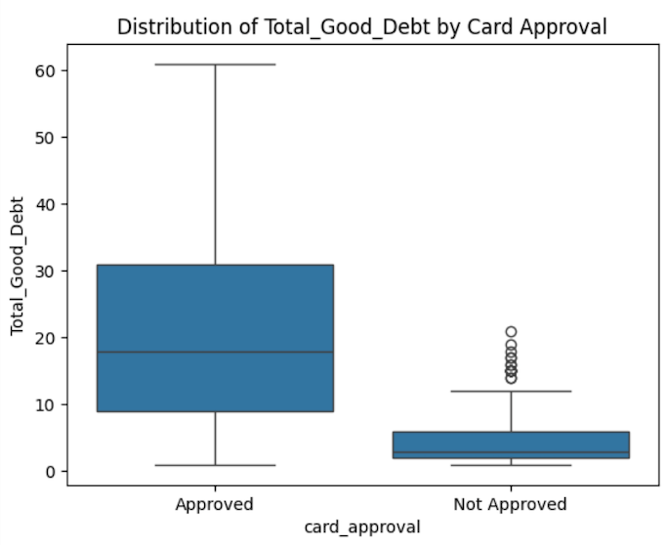
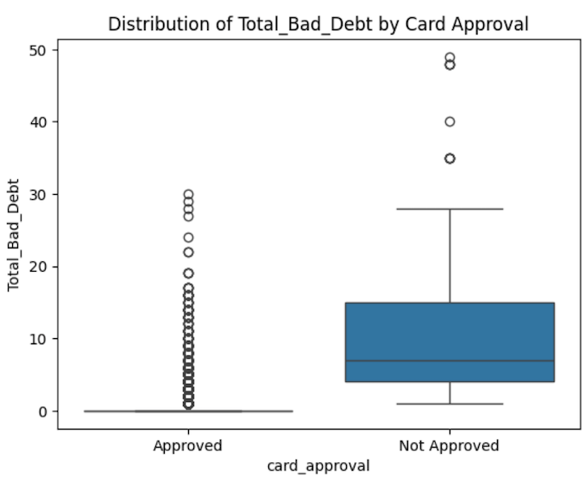
3
Good Debt VS Bad Debt
As anticipated, our analysis reveals a clear distinction between good and bad debt: notably, a higher proportion of not approved applications coincide with bad debt, while approved applications predominantly feature good debt.

Slide 9
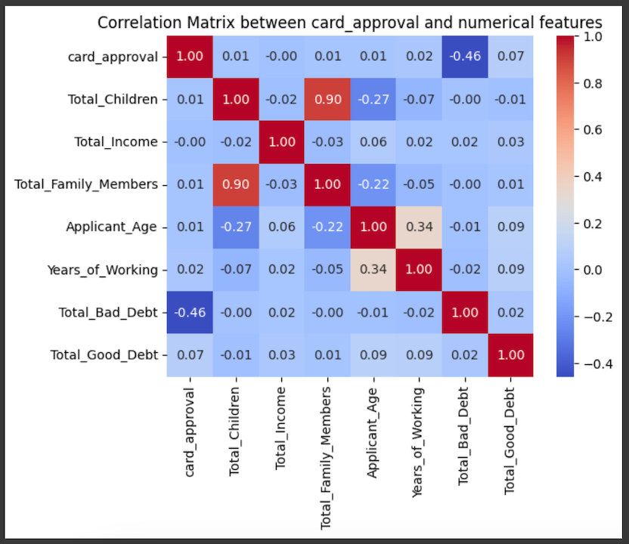
4
Heatmap
This heatmap illustrates a correlation matrix between credit card approval status and various numerical features.

Slide 10
Machine Learning &
Model Evaluation

Slide 11


Methodology
EXPLORATORY DATA ANALYSIS (EDA)
DATA ENGINEERING FEATURES
FEATURE SELECTION

Slide 12
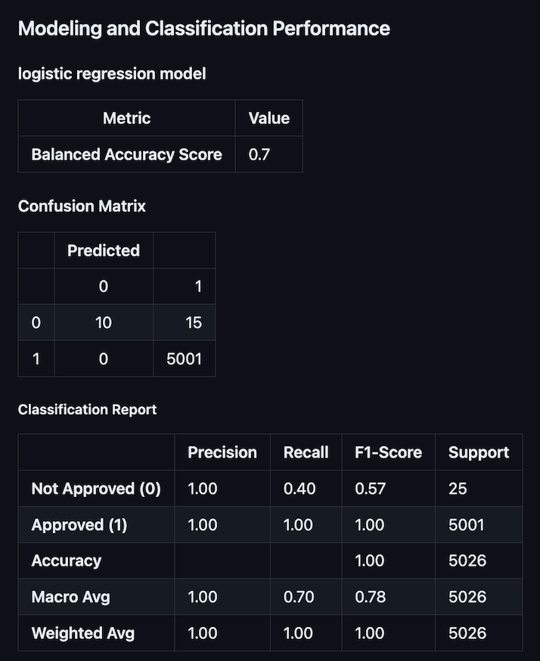
Modeling and Classification Performance
The logistic regression model is accurate for approved applications but struggles to identify unapproved ones, needing improvement in recall for unapproved cases to enhance overall performance.

Slide 13
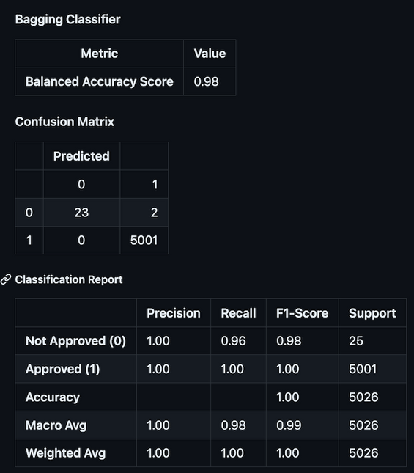
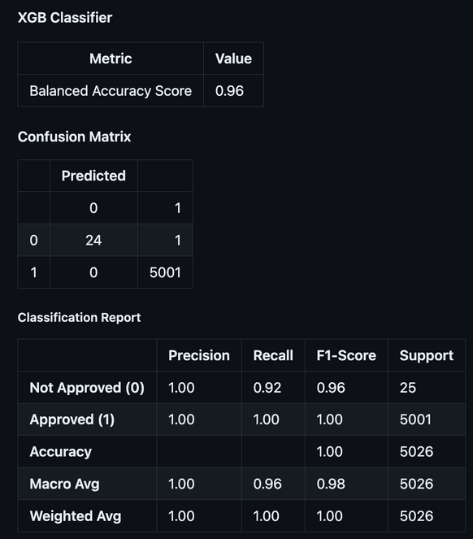
Lazy Predict
Bagging Classifier
XGB Classifier
The Bagging Classifier excels with a remarkable balanced accuracy score of 0.98, accurately predicting both approved and unapproved credit card applications.
The XGB Classifier achieves a high 0.96 balanced accuracy, accurately predicting credit card approvals, but its recall for unapproved applications slightly drops to 0.92, with just 25 instances. Nonetheless, it provides valuable insights for issuers.

Slide 14
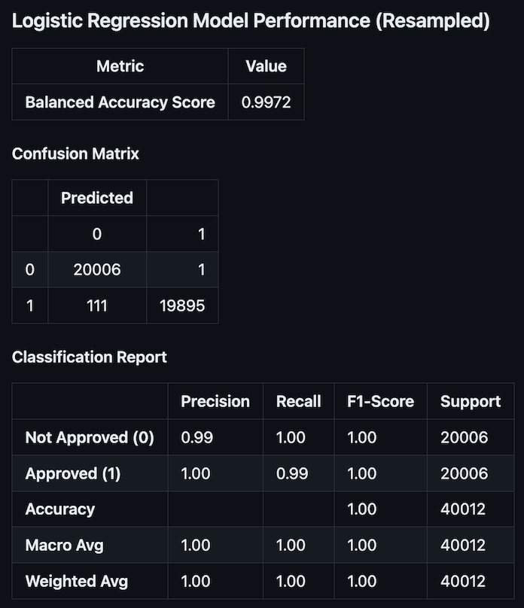
Dataset balancing for optimization
The model shows exceptional performance with a high balanced accuracy score, indicating accurate predictions for both classes in the balanced dataset post-resampling. The confusion matrix reveals minimal misclassifications, with high precision, recall, and F1-scores for both classes. Overall, it demonstrates outstanding accuracy and precision in predicting credit card approval outcomes.

Slide 15
Conclusion
&
Recommendation

Slide 16
Conclusion
Model Performance: Logistic Regression, Bagging Classifier, and XGB Classifier show strong accuracy and precision in predicting credit card approvals, with balanced accuracy scores near 1.0, indicating robustness.
Data Imbalance: Initial dataset imbalance, with more approved than unapproved applications, is tackled effectively by resampling techniques like oversampling and undersampling, enhancing model performance and generalization.
Feature Importance: Features like income, education, and family status play significant roles in credit card approval, offering insights for decision optimization.

Slide 17
Recommendation
Model Deployment: Put the trained models into action to automatically approve credit cards, making decisions faster.
Continuous Monitoring: Keep an eye on how well the models are doing regularly, updating them when needed to keep up with changes.
Interpretability: Make it easier to understand why the models make certain decisions, building trust and following rules.
Customer Segmentation: Split customers into groups based on their credit info, so we can offer them what they want, keeping them happy and staying with us.

Slide 18
Questions?

